Slide 1
DSC640 – Michael Ersevim
Week 1 & 2
Code and Graphs

Slide 2
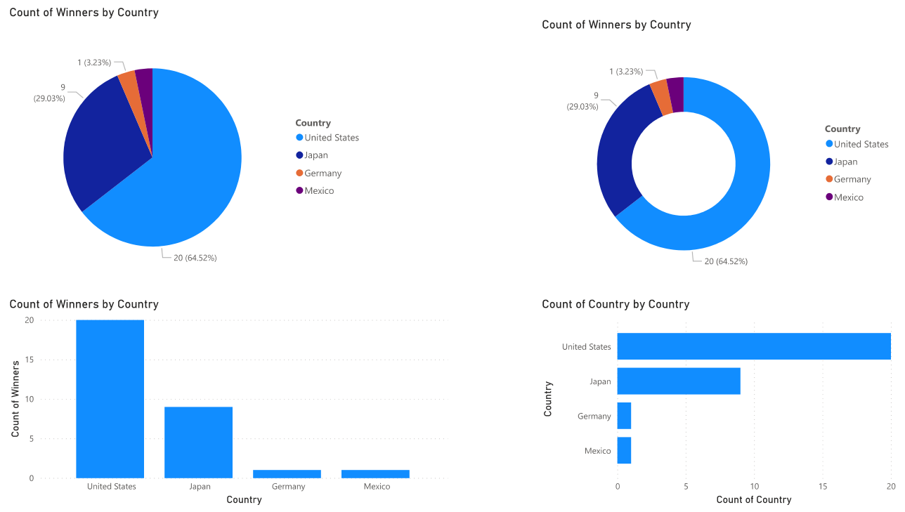
PowerBI Graphs

Slide 3
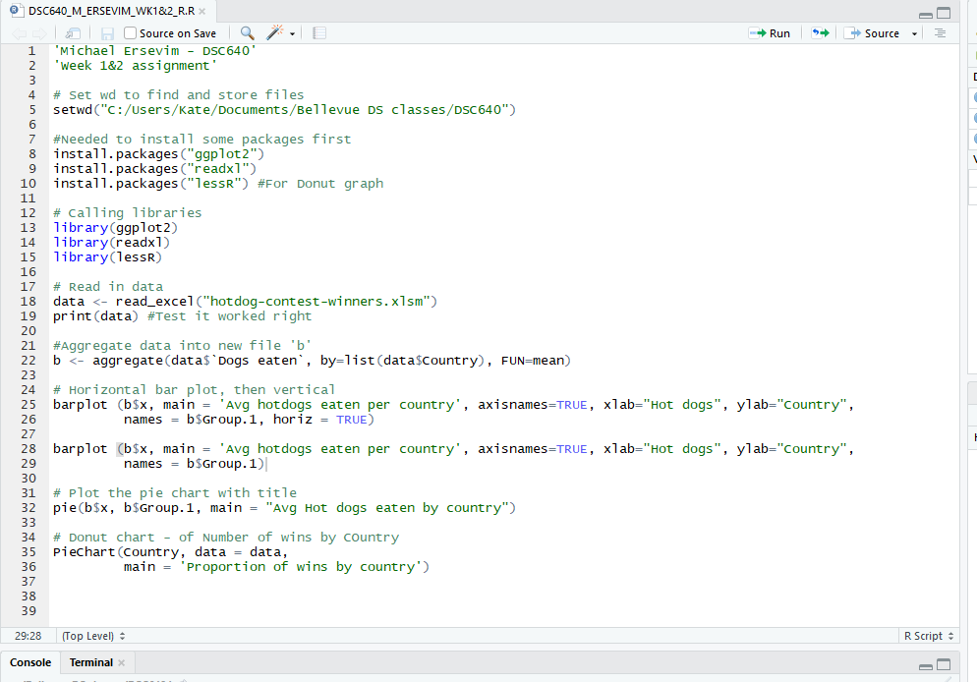
R-Code and Graphs

Slide 4
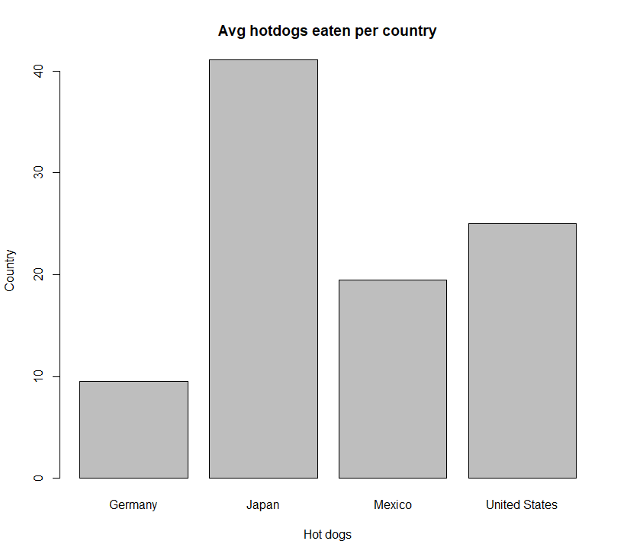
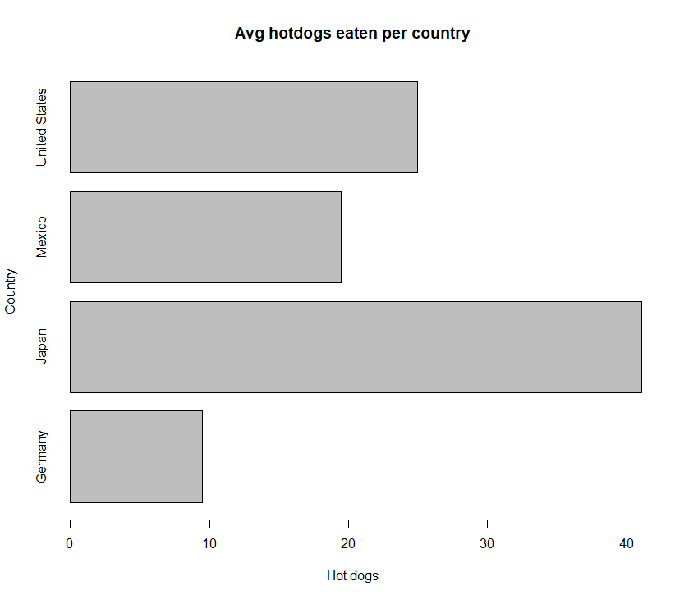
R-Code and Graphs

Slide 5
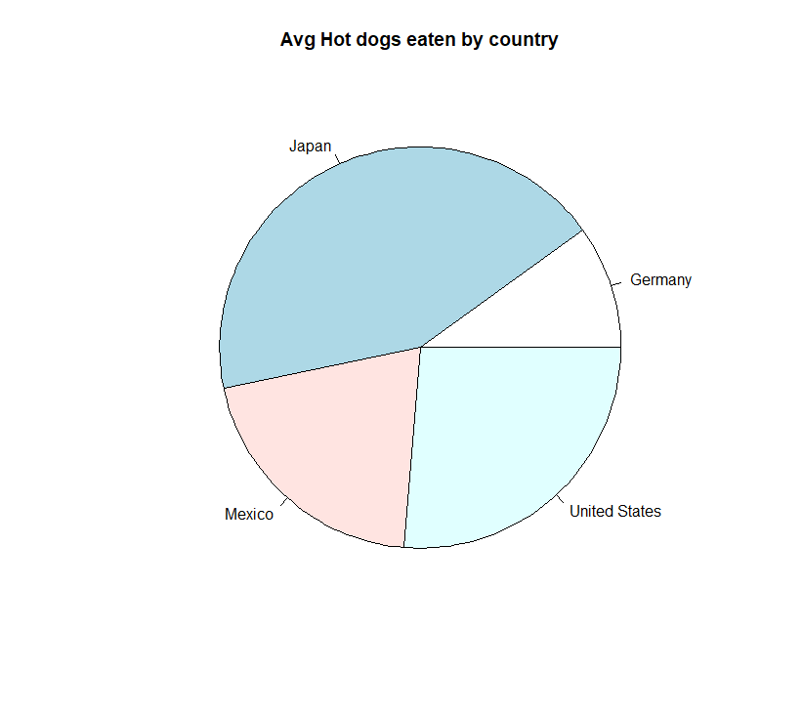
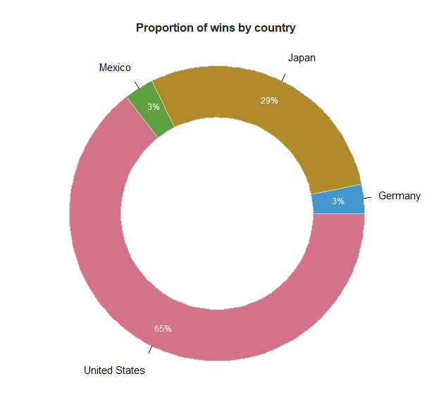
R-Code and Graphs

Slide 6
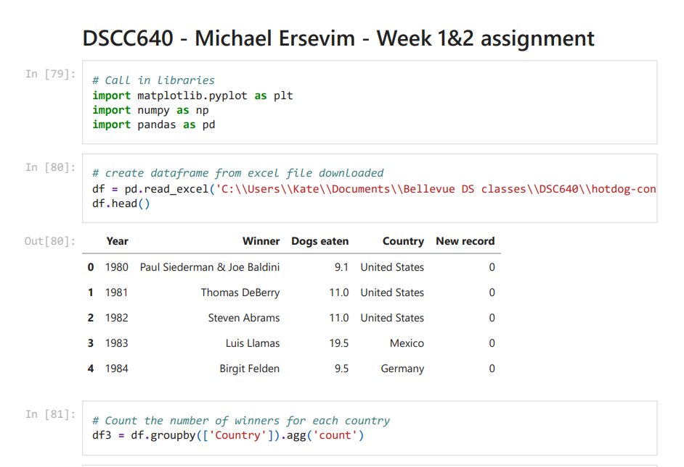
Python - Code and Graphs

Slide 7
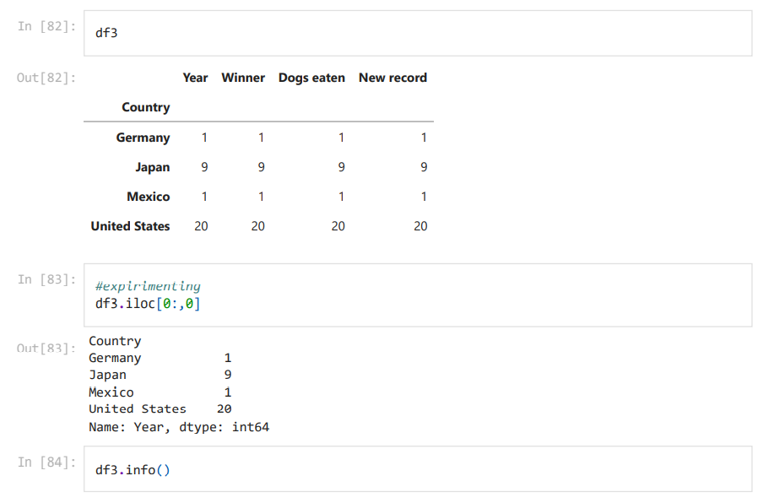
Python - Code and Graphs

Slide 8
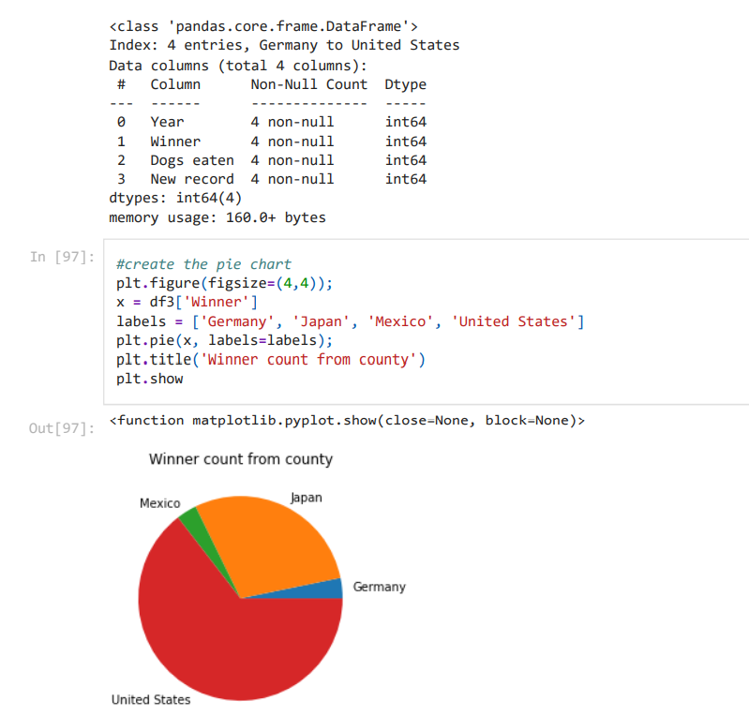
Python - Code and Graphs

Slide 9
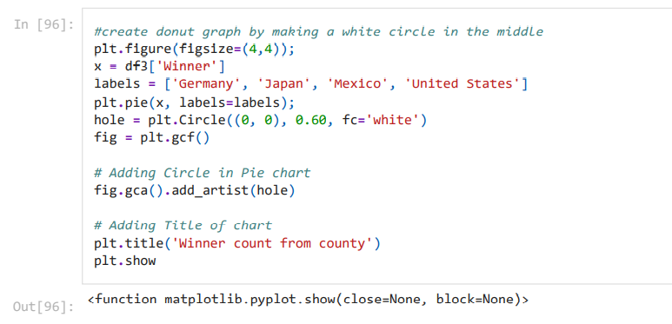
Python - Code and Graphs

Slide 10
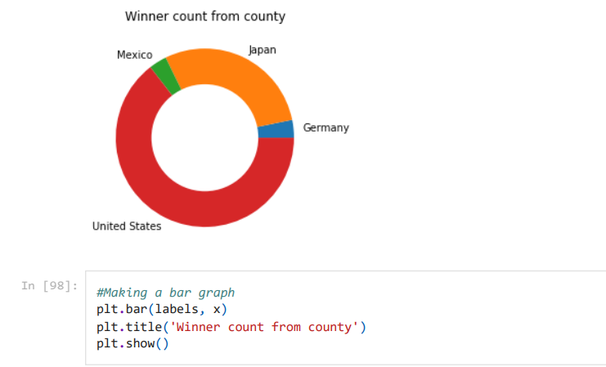
Python - Code and Graphs

Slide 11
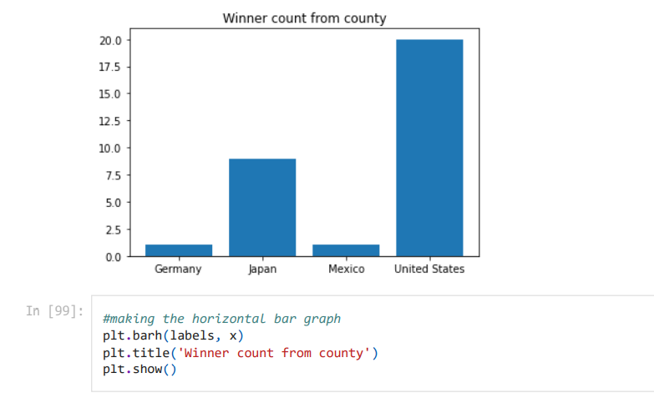
Python - Code and Graphs

Slide 12
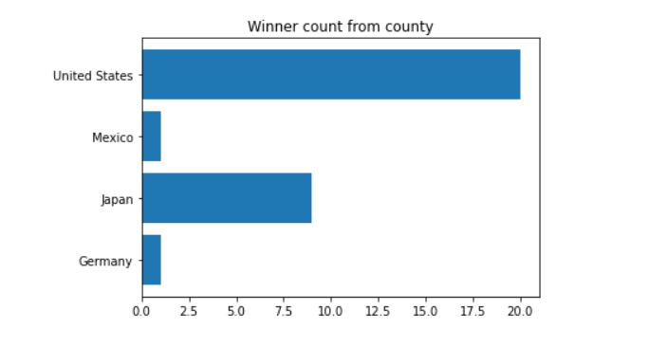
Python - Code and Graphs

